Slide 1
Vehicle Management System
Presented by:
Muhammad Abdullah (052)
Abdullah Khalid (007)

Slide 2
Introduction:
Purpose:
Manage vehicle data like maintenance and trips.
Keep all vehicle data neat and easy to find.
Make tracking easy for users.
Objectives:
Build a simple database for vehicle records.
Create an easy-to-use web interface.
It is basically for driver management companies.
Motivation:
Make vehicle management faster.
Reduce costs with better tracking.

Slide 3
Scope:
Stores information about:
Each vehicle
The drivers
The trips they take
Fuel usage
Repairs and maintenance
Useful for companies with many vehicles (e.g., transport or delivery businesses)
Reduces the need for paper records
Makes it easier to find and manage vehicle information

Slide 4
Functionalities:
Vehicle Class Functionality:
Stores vehicle information like vehicleID, model, type, and registration number.
Driver Class Functionality:
Manages driver details such as driverID, name, licenseNumber, and contactInfo.
Trip Class Functionality:
Handles trip details including tripID, vehicleID, driverID, startLocation, endLocation, date, and distance.

Slide 5
FuelRecord Class Functionality:
Keeps records of fuel usage using attributes like fuelID, vehicleID, date, fuelType, quantity, and cost.
MaintenanceRecord Class Functionality:
Manages maintenance data such as maintenanceID, vehicleID, date, description, and cost.
Compliance class Functionality:
Allows adding, viewing, updating, deleting compliance records and checking for expiry.
Reservation class Functionality:
Enables vehicle booking, viewing, updating, canceling reservations, and checking availability.

Slide 6
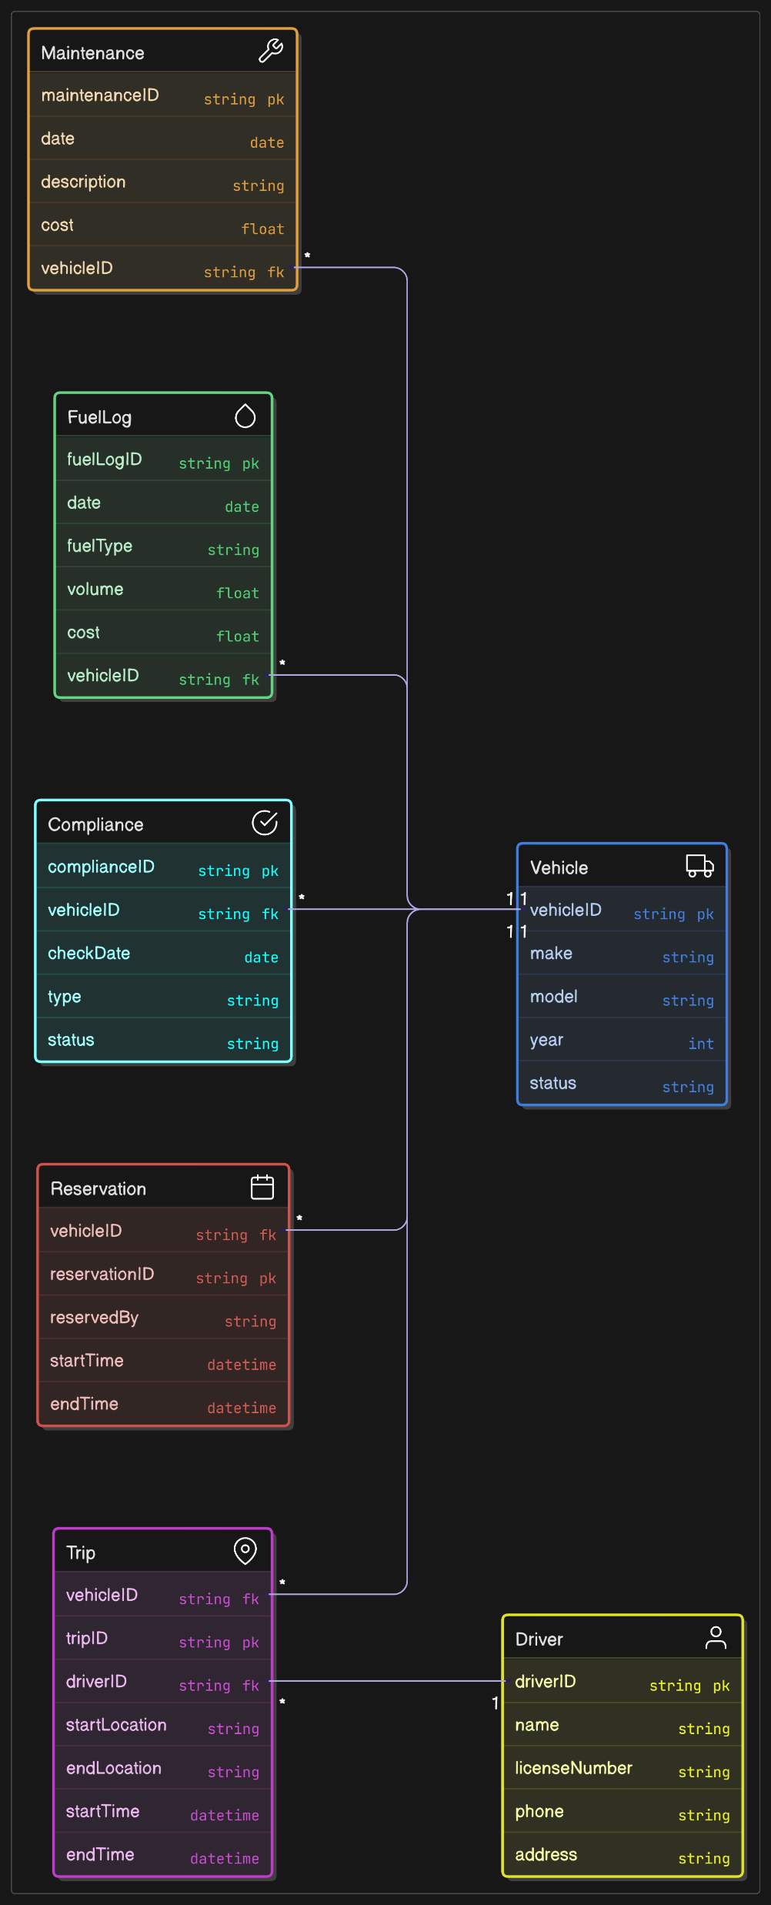

Slide 7
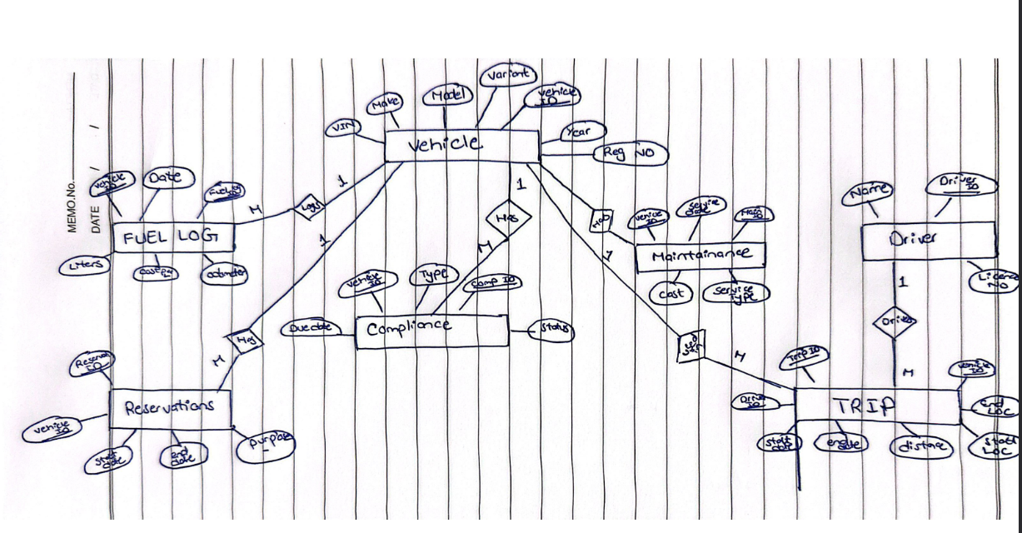
ER Diagram

Slide 8
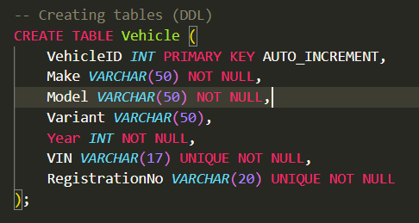
Vehicle Table:
Normalization
1NF: All attributes (VehicleID, Make, Model, Variant, Year, VIN, RegistrationNo) are atomic, and VehicleID ensures unique records. Satisfied.
2NF: Since the primary key is VehicleID (a single attribute), there are no composite keys, so partial dependencies are not possible. All attributes depend on VehicleID. Satisfied.
3NF: There are no transitive dependencies. For example, Make, Model, Variant, Year, VIN, and RegistrationNo depend directly on VehicleID, and none depend on each other (e.g., Model does not depend on Make). Satisfied.
Conclusion: The Vehicle table is in 3NF.

Slide 9
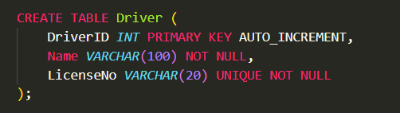
Driver table
1NF: Attributes (DriverID, Name, LicenseNo) are atomic, and DriverID ensures uniqueness. Satisfied.
2NF: The primary key is DriverID (single attribute), so no partial dependencies exist. Satisfied.
3NF: Name and LicenseNo depend directly on DriverID, and there’s no dependency between Name and LicenseNo. Satisfied.
Conclusion: The Driver table is in 3NF.

Slide 10
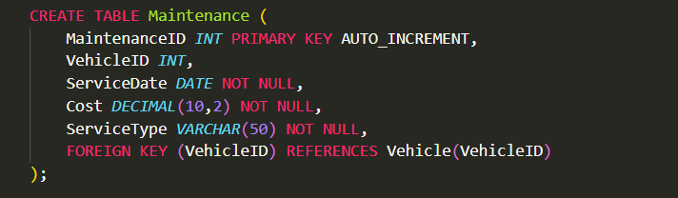
Maintenance Table
Normalization
1NF: All attributes are atomic, and MaintenanceID ensures uniqueness. Satisfied.
2NF: The primary key is MaintenanceID (single attribute), so no partial dependencies. Satisfied.
3NF: Attributes (VehicleID, ServiceDate, Cost, ServiceType) depend on MaintenanceID. There’s no transitive dependency (e.g., Cost does not depend on ServiceType). Satisfied.
Conclusion: The Maintenance table is in 3NF.

Slide 11
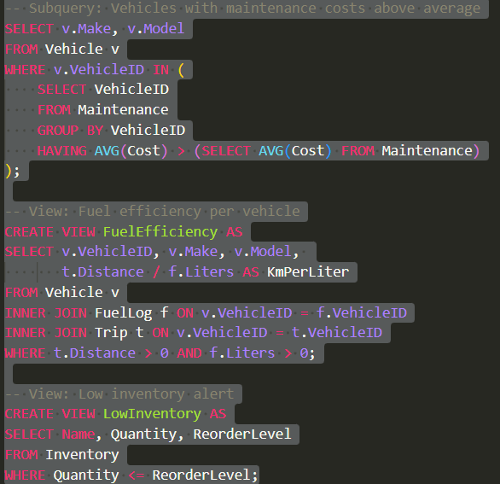
View function to fetch data
)
);

Slide 12
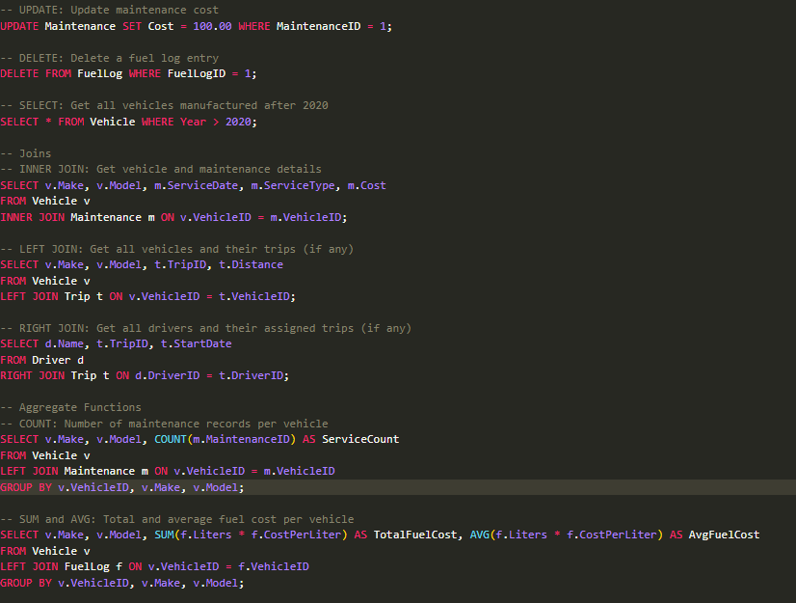
Select and Update query

Slide 13
Languages and server use for project
Server: Laragon
Back-End: Php Js
Fornt-End: Html Css Js

Slide 14
Conclusion
This project basically for Driver management company which help them in managing their companies by using different functionalities like FuelLog and maintenance track to use vehicle in long term .
In project view it is best for solving and practicing SQL quires and learning
Multiple languages like JavaScript, Php, Html, CSS.

Slide 15
Thank You.

